Slide 1
Degree Plan Checker &
Recommender
Presented by Xiaoli Sun & Yong Zhou

Slide 2
Database Design
Course Table:
Core - Int
Advanced - Int
Dcode - Str
Cno - Int
Cname - Str
Area- Str
Prereq/Coprereq Table:
Dcode - Str
Cno - Int
Pcode - Str
Pno - Int
Study Plan Table:
Name- Str
Study plan array:
Dcode -Str
Cno - Int
Cname - Str
Grade - Str
Area - Str
InterestedArea array: Str
Cs530_cond - Int
CS531_cond - Int

Slide 3
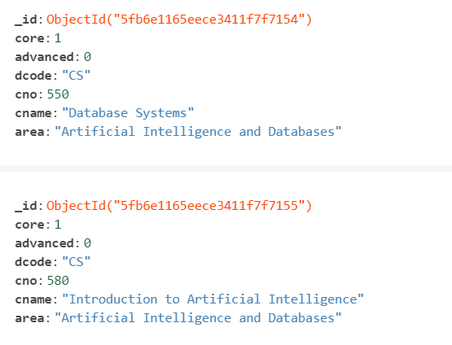
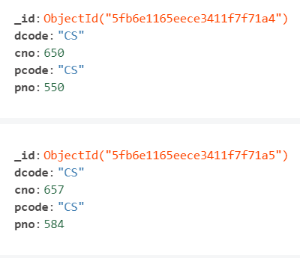
Database Design(Cont)
Course Collection in Mongodb
Prereq Collection in Mongodb

Slide 4


Project Structure
Back-end
Python Flask
Mongodb

Slide 5
Python Flask
Micro web application framework
Provides functional and extensible but concise cores
Open-source
Provides lightweight and modular design, allow developers to get started fast and easy in developing applications
Allow python comprehensions as a query language for JSON

Slide 6

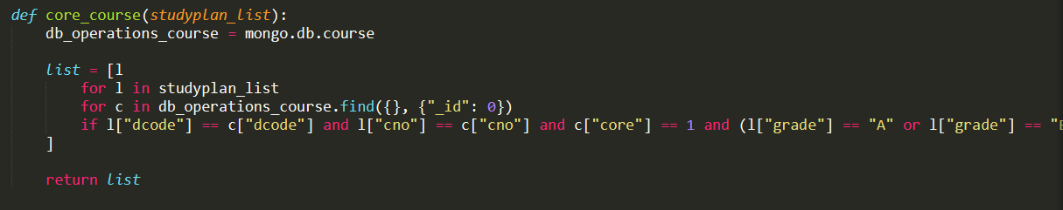
Python Flask(Cont.)
Database Configuration:
Python list comprehension example:

Slide 7
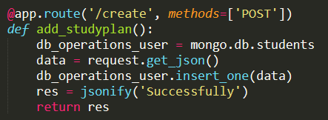
Python Flask(Cont.)
API call example(Create study plan):

Slide 8

Project Structure
Front-end
Angular

Slide 9
ANGULAR
Applications are built with one or multiple components
Each Component is consist of:
A component(TypeScript) class handles data and functionality
An HTML template the displays the UI
A CSS selector that determine the style of UI
Provides a simplified client HTTP API for communicating with backend
Allow in-app navigation with routing

Slide 10
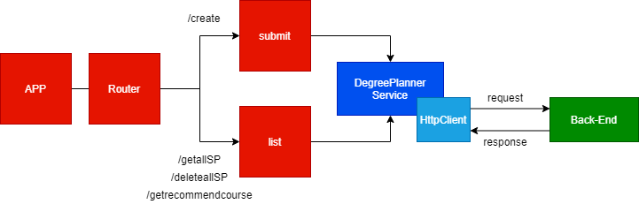
ANGULAR(Cont.)

Slide 11
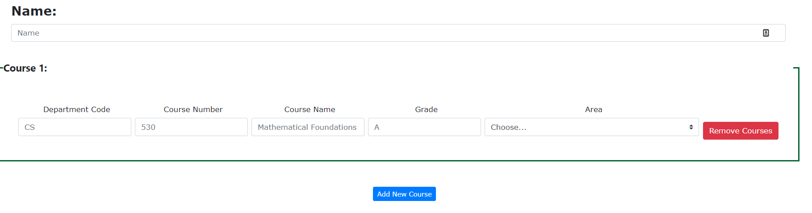
ANGULAR(Cont.)
Main Page

Slide 12
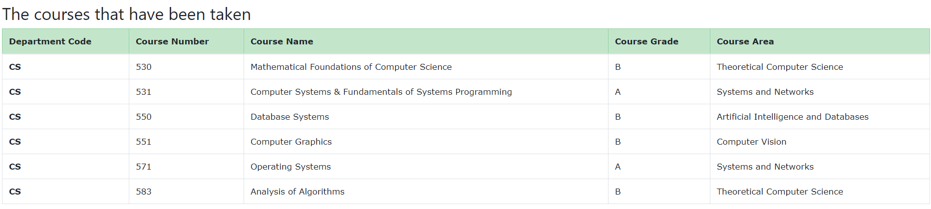
ANGULAR(Cont.)
Course List

Slide 13
IT’S TIME TO SHOW OUR DEMO

Slide 14
References
Angular Components (https://angular.io/guide/component-overview)
Python Flask (https://flask.palletsprojects.com/en/1.1.x/foreword/#what-does-micro-mean)

Slide 15
QUESTION?

